Slide 1
Strategic Trade Policy
Junhao WANG
Maël STEUNOU
Nicolas SPORRER
Shiwen XU

Slide 2
Plan
Concepts of Strategic Trade Theory and Game’s Theory
Case of Airbus/Boeing
Role of WTO
Q/A

Slide 3
Strategic Trade Theory
Strategic advantage
Industry dominated by a small number of fims
Raise the level of domestic welfare
Shifting profits from foreign to domestic firms
Strategic use of export subsidies, import tariffs and subsidies to R&D or investment, etc.
Resembling the Prisoner’s dilemma

Slide 4
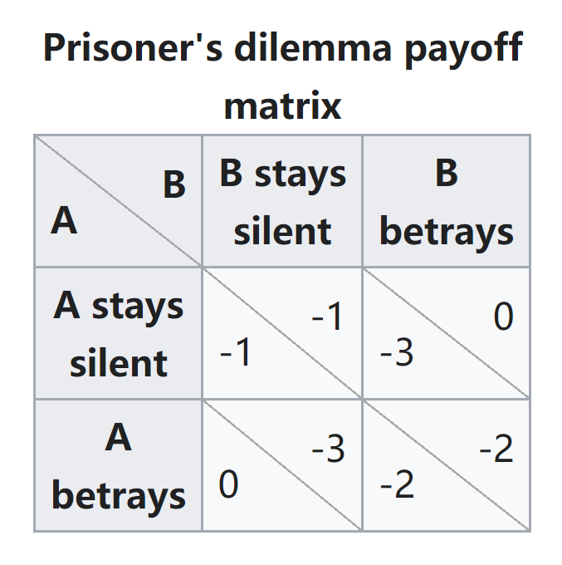
Game Theory and Prisoner’s Dilemma
If A and B each betray the other, each of them serves two years in prison
If A betrays B but B remains silent, A will be set free and B will serve three years in prison
If A remains silent but B betrays A, A will serve three years in prison and B will be set free
If A and B both remain silent, both of them will serve only one year in prison

Slide 5
Nash Equlibrium in Prisoner’s Dilemma
Nash equilibrium in game theory is a situation in which a player will continue with their chosen strategy, having no incentive to deviate from it, after taking into consideration the opponent's strategy.
Determine the results and then choose the optimal strategy
Take into consideration the possible strategies that both players could choose
Both players will betray each other

Slide 6
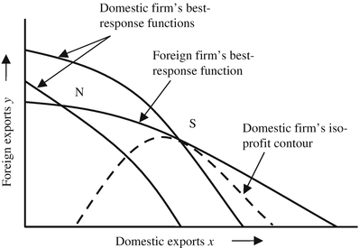
Strategic Trade Policy Effect
The subsidy lowers the home firm’s cost and makes it want to export more
Foreign firm reduces its output
The domestic export subsidy increases, aggregate quantity rises, price fall, the profits of the domestic firm rise
The foreign profits decline
Rents shifted from the foreign firm to the home firm

Slide 7

Boeing/Airbus
Context of a dispute
Introduction:
The Boeing / Airbus duel began in 1972
Boieng is the American aircraft manufacturer
Airbus is the European aircraft manufacturer
The market is closed, only 2 competitors
If an airline choose a “family” of plane, they won’t change because of the switching cost (money, work skills, processes)
Beginning of the dispute:
In 2004, the US launch a formal dispute at the WTO concerning the subsidies of EU for Airbus
America declares that EU subsidies for aircraft makers broke global trade rules but in the same time also gives provide Boeing with subsidies

Slide 8
Boieng and airbus - the dispute
From the EU side to Airbus: subsidies, cheapest loans possibles
From the Amercan side Airbus: subsidies, exclusivity contracts with the defense department and tax breaks
High complexity of discussion, requirements to assure to keep information private
A deal could be if both companies stops recieving subsidies but will impact all countries as customers (even China, Canada, and so on)
Since discussions failed, in 2019 WTO authorizes new US retaliatory tariffs for 7.5B$ of imported products (alcohol, cheese, clothes,...)
25% of tariffs for certain products and 10% on plane, but America’s companies such as Delta airlines already planned purchases for years with airbus
Pieces for plane manufacturing are coming from several countries and assembled in America (Alabama for examples)
About the possible evolution:
If WTO confirm that EU stops subsidies and their effects, these tariffs won’t be legit anymore
WTO authorize EU to countermeasure US with tariffs
America is blocking the appointment of judges to the WTO’s court of appeals and no new complaint could be taken into account if one or both decide to ignore the rules
→ Both sides could decide whether to put more tariffs, status quo or alleviate it
Notes:
2. Both sides disputes in front of WTO regarding out of rules actions
1st they tried to settle an arragement

Slide 9
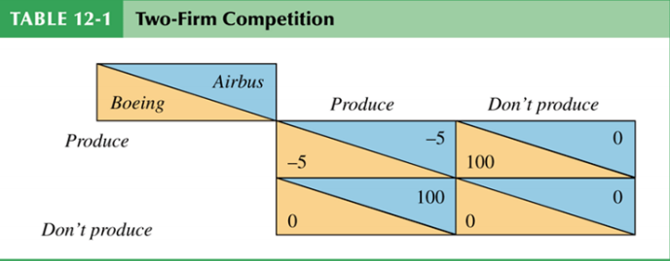
Boeing/Airbus
game theory (1/2)
Two firms in the international market located in different countries
Situation comparable to Prisoner’s dilemna
The concept of first mover advantage
Nash equilibriums are DP/P or P/DP

Slide 10
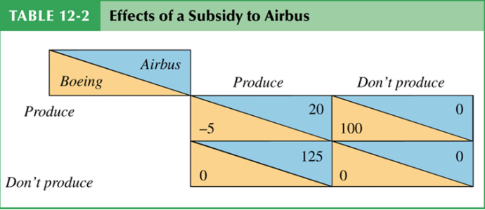
BOEING/AIRBUS
Game’s theory (2/2)
Same situation with the impact of subsidies
EU gives 25 to Airbus : what happens?
Because of the subsidy, Boeing does not want to enter the industry
Only one N.E : DP/P
Tax on profits can compensate tax payers
Possibility that Boeing has a production advantage

Slide 11
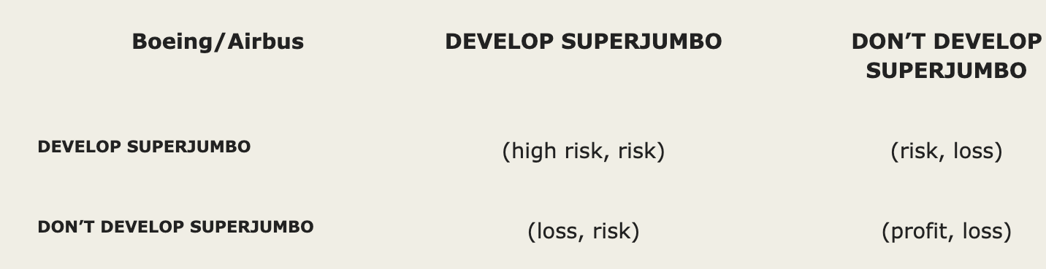
BOEING/AIRBUS
developer’s dilemna
Article by Kretschmer defines the developer’s dilemna
Early 90’s, Boeing and Airbus were looking to develop a “superjumbo” class of commercial airliners
Investment of large amount of money into developing a new market
Alliance formed by Airbus and Boeing in 1993 to develop a Very Large Commercial Transport
Lack of commitment from Boeing => Airbus withdraws from the alliance => what should Boeing do?
Boeing chose not to develop : “Market is not ready yet”
Boeing payoff for leaving the new market untapped was positive. Airbus one was negative.

Slide 12
Boeing/airbus
Rivals in arms?
Boeing and Airbus are a duopoly, but others actors are threatening their superiority
With the developers dilemna, the risk is also to create the opportunity for other smaller competitors : either you do not develop and there is un untapped market, or you develop but you leave do not focus anymore on the market you were leading
Bombardier, Embraer
Many argue that they cannot be a sufficient threat
Case of ERJ-195 competing Boeing’s new 737 MAX : “If you can’t beat them, join them”
Flop of 737 MAX, and commercial flop from A380 for example.
Boeing and Airbus compete, but at the same time they arrange themselves to keep their positions, as Embraer and Bombardier are helping them a lot on the regional market

Slide 13
Role of WTO
The World Trade Organization (WTO) is an intergovernmental organization that regulates and facilities international trade between nations. It was founded in 1995, replacing the General Agreement on Tariffs and Trade (GATT) that was established in 1948.
The WTO is the world’s largest international economic organization, with 164 member states representing over 96% of global trade and global GDP.

Slide 14
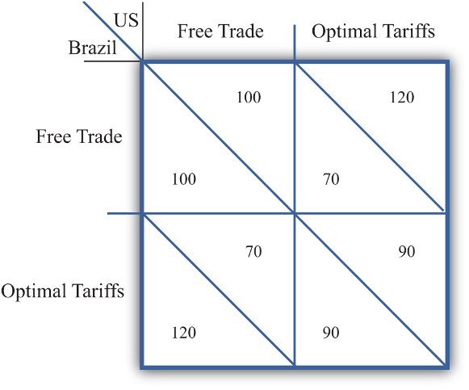

Role of WTO
Key Objectives of WTO:
to set and enforce rules for international trade
to provide a forum for negotiating and monitoring further trade liberalization
to resolve trade disputes
to increase the transparency of decision-making processes
to cooperate with other major international economic institutions involved in global economic management
to help developing countries benefit fully from the global trading system
Cooperative vs. Non-cooperative Nash Equilibrium

Slide 15
Achievements vs. Criticism
WTO’s Achievements since 1995:
The dollar value of world trade has nearly quadrupled, while the real volume of world trade has expanded by 2.7 times, which far outstrips the two-fold increase in world GDP over that period
Average tariffs have almost halved, from 10.5% to 6.4%
Enabled the commencement of global value chains which accounts for 70% of total merchandise trade
Criticism on WTO:
● Economic growth?
El Salvador removed all its quantitative barriers imports and cut tariffs in the early 1990s. Economic growth remained weak
Vietnam in the late 1980s decided to liberalize slowly and implemented safeguards for domestic commerce. Successfully accelerated economic growth and reduced poverty
● Reduce poverty?
- High income and wealth inequality in China and India despite fast economic growth from free trade

Slide 16
Thank you !
Questions?

